Slide 1


Panel Data Regression
Ekonometrika untuk Penelitian
Muhammad Akmal Farouqi
11/6/2024
www.ugm.ac.id
Locally Rooted, Globally Respected

Slide 2
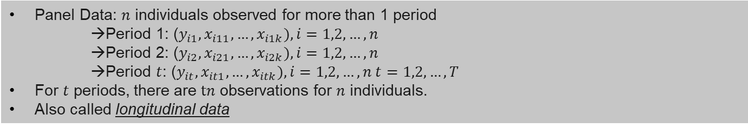
Structure
Panel Data: $n$ individuals observed for more than 1 period
→Period 1: ($y_{i1},x_{i11},…,x_{i1k}),i=1,2,…,n$
→Period 2: ($y_{i2},x_{i21},…,x_{i2k}),i=1,2,…,n$
→Period $t$: ($y_{it},x_{it1},…,x_{itk}),i=1,2,…,n t=1,2,…,T$
For $t$ periods, there are $tn$ observations for $n$ individuals.
Also called longitudinal data
In panel data settings, outcome variable likely to be correlated overtime (ex: Indonesia’s GDP in 2021 to 2022)
main advantage of using panel data is the ability to control unobserved characteristic that relatively static over time.
Easier to achieve larger observations (demands smaller individuals)
However, it can be challenging for disaggregated level (people or families) (attrition problem)

Slide 3
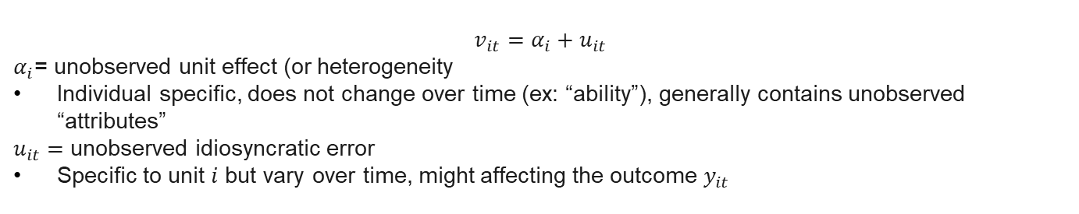
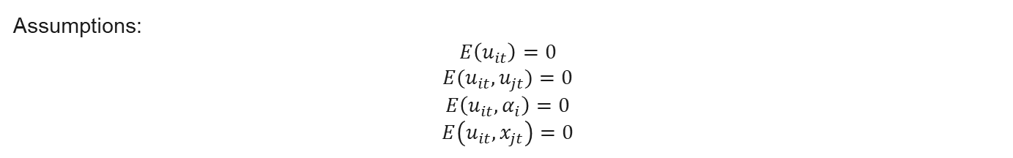
Composite Error Component
$$v_{it}=α_{i}+u_{it}$$
$α_{i}$= unobserved unit effect (or heterogeneity
Individual specific, does not change over time (ex: “ability”), generally contains unobserved “attributes”
$u_{it}=$ unobserved idiosyncratic error
Specific to unit $i$ but vary over time, might affecting the outcome $y_{it}$
Assumptions:
$$E\left(u_{it}\right)=0$$
$$E(u_{it},u_{jt})=0$$
$$E\left(u_{it},α_{i}\right)=0$$
$$E\left(u_{it},x_{jt}\right)=0$$

Slide 4
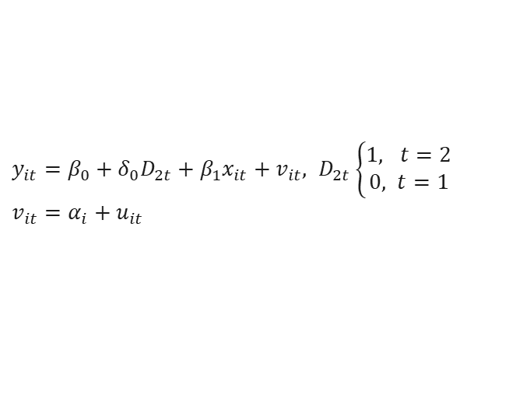
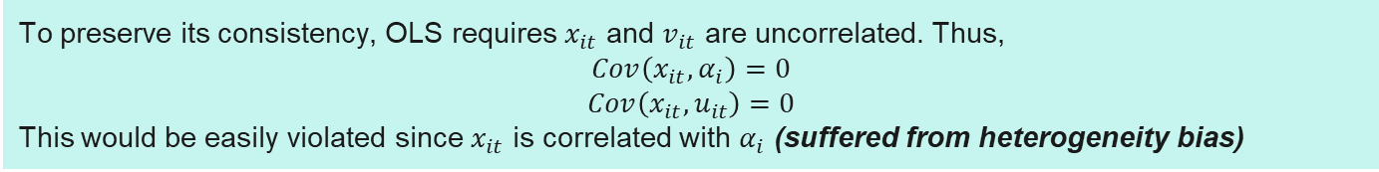
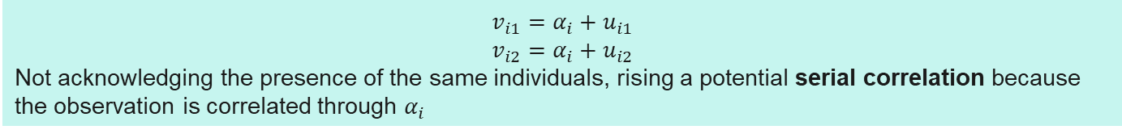
Basic Equation: Two-periods of panel data
$y_{it}=β_{0}+δ_{0}D_{2t}+β_{1}x_{it}+v_{it}, D_{2t}\left\{\begin{aligned}1, t=2 \\ 0, t=1\end{aligned}\right.$
$v_{it}=α_{i}+u_{it}$
Time-fixed effect, time dummy
OLS can be performed to estimates this eq. (for panel data we called it Pooled OLS (POLS). But, few important issues arise with the POLS estimator
$$v_{i1}=α_{i}+u_{i1}$$
$$v_{i2}=α_{i}+u_{i2}$$
Not acknowledging the presence of the same individuals, rising a potential serial correlation because the observation is correlated through $α_{i}$
To preserve its consistency, OLS requires $x_{it}$ and $v_{it}$ are uncorrelated. Thus,
$$Cov\left(x_{it},α_{i}\right)=0$$
$$Cov\left(x_{it},u_{it}\right)=0$$
This would be easily violated since $x_{it}$ is correlated with $α_{i}$ (suffered from heterogeneity bias)

Slide 5
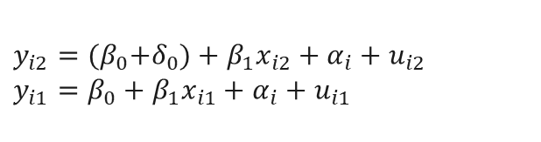
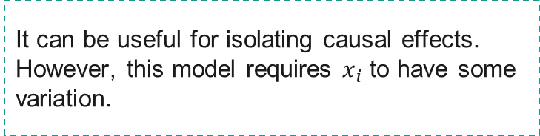
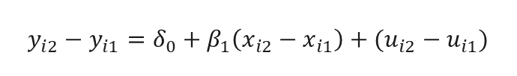
First Difference Estimator
Differencing the variables across period can become a solution to eliminate the source of bias in POLS
Subtract period 2 to period 1
$y_{i2}={(β}_{0}+δ_{0})+β_{1}x_{i2}+α_{i}+u_{i2}$
$y_{i1}=β_{0}+β_{1}x_{i1}+α_{i}+u_{i1}$
It can be useful for isolating causal effects.
However, this model requires $x_{i}$ to have some variation.
$$y_{i2}−y_{i1}=δ_{0}+β_{1}\left(x_{i2}−x_{i1}\right)+(u_{i2}−u_{i1})$$
Moreover, we have to careful in estimating more than 2 period because it is no longer a cross-sectional data!
$$∆y_{i}=δ_{0}+β_{1}∆x_{i}+∆u_{i}$$
Notes:
You can visit the discussion about FE vs FD here
https://economics.stackexchange.com/questions/45456/fixed-effects-vs-first-difference

Slide 6
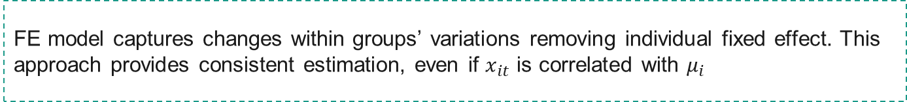



Fixed Effect (Within Estimator)
FE model captures changes within groups’ variations removing individual fixed effect. This approach provides consistent estimation, even if $x_{it}$ is correlated with $μ_{i}$
Consider panel data eq below
Since 𝛼 depicts a constant value of individual-specific unobservable effects, subtracting it might erase the effect
$y_{it}=β_{1}x_{it}+α_{i}+u_{it}, t=1,2,..,T$
We calculate within-groups’ average
${\overline{y}}_{i}=β_{1}{\overline{x}}_{i}+α_{i}+{\overline{u}}_{i}$
Subtracting panel data eq with its with groups’ average
← Within-groups transformation
${\ddot{y}}_{it}=β_{1}{\ddot{x}}_{it}+{\ddot{u}}_{it}$

Slide 7
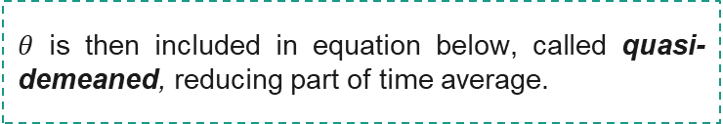
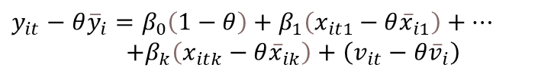
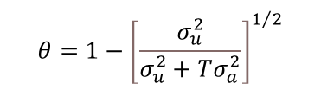
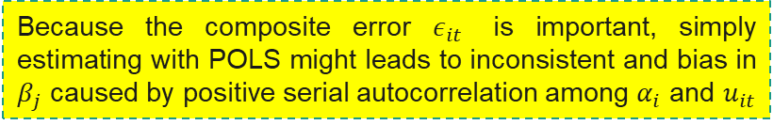

Random Effect
Unlike FE, RE model treats individual-specific unobservable variables as random and uncorrelated with explanatory variables (but might correlated with explained variable)
$$y_{it}=β_{0}+β_{1}x_{it1}+…+β_{k}x_{itk}+ε_{it}$$
$ε_{it}=α_{i}+u_{it}$
Because the composite error $ε_{it}$ is important, simply estimating with POLS might leads to inconsistent and bias in $β_{j}$ caused by positive serial autocorrelation among $α_{i}$ and $u_{it}$
Hence RE implements GLS transformation to eliminates serial correlation in error below:
$θ$ is then included in equation below, called quasi-demeaned, reducing part of time average.
$$θ=1−{\left[\frac{σ_{u}^{2}}{σ_{u}^{2}+Tσ_{a}^{2}}\right]}^{1/2}$$
$y_{it}−θ{\overline{y}}_{i}=β_{0}\left(1−θ\right)+β_{1}\left(x_{it1}−θ{\overline{x}}_{i1}\right)+…$
$+β_{k}\left(x_{itk}−θ{\overline{x}}_{ik}\right)+\left(v_{it}−θ{\overline{v}}_{i}\right)$

Slide 8

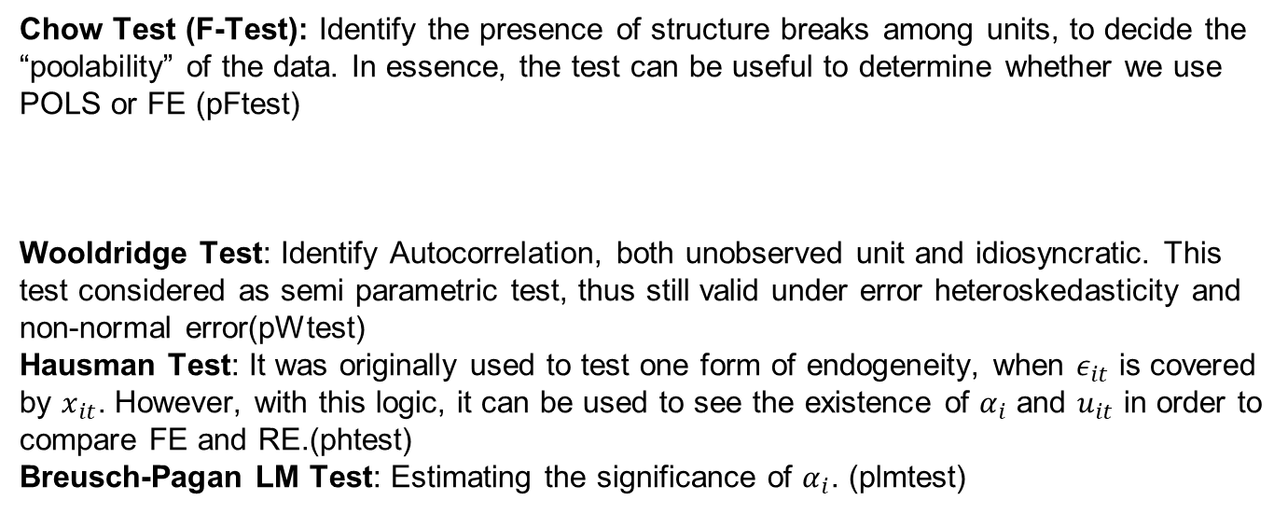
Several Tests
Chow Test (F-Test): Identify the presence of structure breaks among units, to decide the “poolability” of the data. In essence, the test can be useful to determine whether we use POLS or FE (pFtest)
Wooldridge Test: Identify Autocorrelation, both unobserved unit and idiosyncratic. This test considered as semi parametric test, thus still valid under error heteroskedasticity and non-normal error(pWtest)
Hausman Test: It was originally used to test one form of endogeneity, when $ε_{it}$ is covered by $x_{it}$. However, with this logic, it can be used to see the existence of $α_{i}$ and $u_{it}$ in order to compare FE and RE.(phtest)
Breusch-Pagan LM Test: Estimating the significance of $α_{i}$. (plmtest)

Slide 9
Dynamic Panel Data Estimation
In some cases, some data might be correlated with it lagged values. Thus, incorporating dynamic aspect in panel data estimation is crucial.
Why dynamic panel estimation is important:
Capturing dynamic in economic relationship
Avoiding misspecification from ignoring lagged dependence
Correcting bias in standard estimators
Better Identification in Growth and Convergence Analysis (captures persistence and adjustment process)
Solving Endogeneity and Initial Conditions Problems

Slide 10
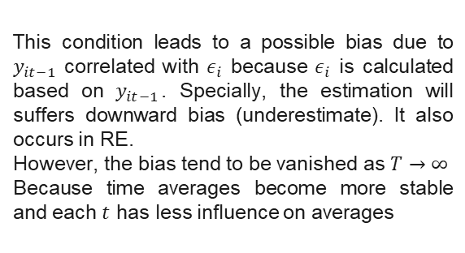

The risk of using static estimation to estimates lagged dependent variable: Nickell Bias (Nickell, 1981)
Nickell investigates the asymptotic bias that arises when estimating dynamic panel data models with individual fixed effects, especially when the time dimension (T) is small and the number of individuals (N) is large
Suppose we have a dynamic panel data model
POLS also not suitable to estimates dynamic panel
$$y_{it}=α+γy_{it−1}+β_{1}x_{it}+ε_{it}$$
OVB because ignoring individual FE
Endogeneity issue from lagged dependent variable
Serial correlation error
Then we estimate this using FE, where:
$${\ddot{y}}_{it}=y_{it}−{\overline{y}}_{i},{\ddot{y}}_{it−1}=y_{it−1}−{\overline{y}}_{i},{\ddot{ε}}_{it}=ε_{it}−{\overline{ε}}_{i}$$
This condition leads to a possible bias due to $y_{it−1}$ correlated with $ε_{i}$ because $ε_{i}$ is calculated based on $y_{it−1}$. Specially, the estimation will suffers downward bias (underestimate). It also occurs in RE.
However, the bias tend to be vanished as $T→∞$
Because time averages become more stable and each $t$ has less influence on averages
Nickell Bias leads to:
Overestimation with POLS
Underestimation with FE/RE

Slide 11
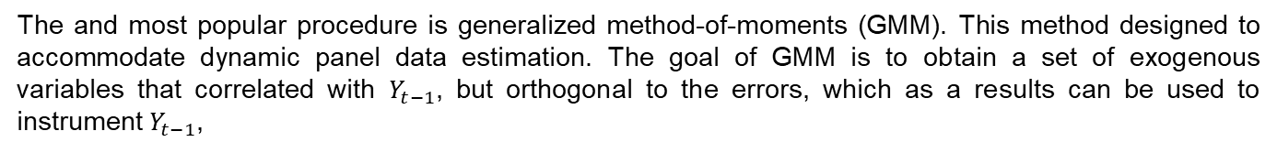
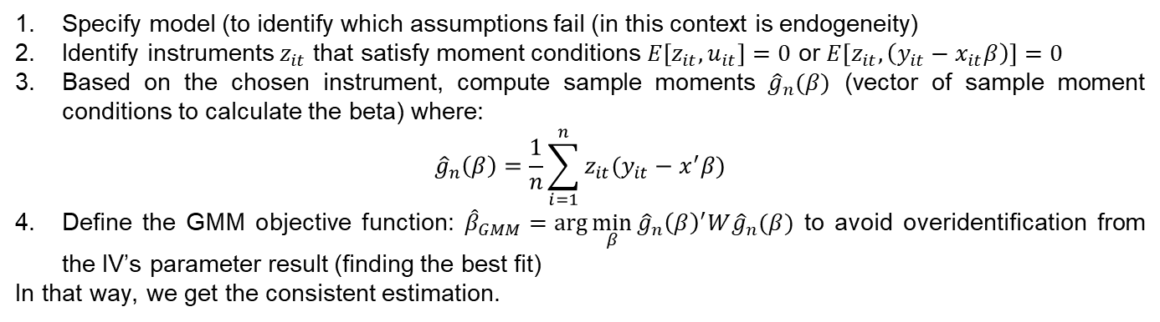
Panel GMM (General Form)
The and most popular procedure is generalized method-of-moments (GMM). This method designed to accommodate dynamic panel data estimation. The goal of GMM is to obtain a set of exogenous variables that correlated with $Y_{t−1}$, but orthogonal to the errors, which as a results can be used to instrument $Y_{t−1}$,
How does it work?
Specify model (to identify which assumptions fail (in this context is endogeneity)
Identify instruments $z_{it}$ that satisfy moment conditions $E\left[z_{it},u_{it}\right]=0$ or $E\left[z_{it},\left(y_{it}−x_{it}β\right)\right]=0$
Based on the chosen instrument, compute sample moments ${\hat{g}}_{n}(β)$ (vector of sample moment conditions to calculate the beta) where:
$${\hat{g}}_{n}\left(β\right)=\frac{1}{n}\sum_{i=1}^{n}{z_{it}(y_{it}−x^{′}β)}$$
Define the GMM objective function: ${\hat{β}}_{GMM}=\arg{\min_{β}{{\hat{g}}_{n}{\left(β\right)}^{′}W{\hat{g}}_{n}(β)}}$ to avoid overidentification from the IV’s parameter result (finding the best fit)
In that way, we get the consistent estimation.

Slide 12
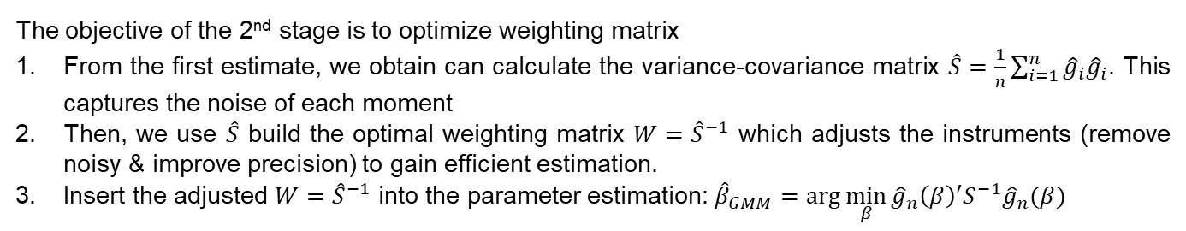
Panel GMM (General Form)
The and most popular procedure is generalized method-of-moments (GMM). This method designed to accommodate dynamic panel data estimation. The goal of GMM is to obtain a set of exogenous variables that correlated with $Y_{t−1}$, but orthogonal to the errors, which as a results can be used to instrument $Y_{t−1}$,
How does it work (2nd Stage)
The objective of the 2nd stage is to optimize weighting matrix
From the first estimate, we obtain can calculate the variance-covariance matrix $\hat{S}=\frac{1}{n}\sum_{i=1}^{n}{{\hat{g}}_{i}{\hat{g}}_{i}}$. This captures the noise of each moment
Then, we use $\hat{S}$ build the optimal weighting matrix $W={\hat{S}}^{−1}$ which adjusts the instruments (remove noisy & improve precision) to gain efficient estimation.
Insert the adjusted $W={\hat{S}}^{−1}$ into the parameter estimation: ${\hat{β}}_{GMM}=\arg{\min_{β}{{\hat{g}}_{n}{\left(β\right)}^{′}S^{−1}{\hat{g}}_{n}(β)}}$

Slide 13
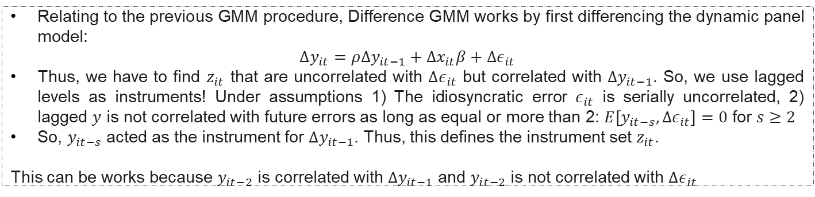
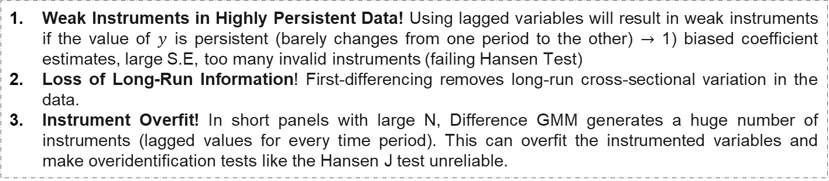
Difference GMM
Difference GMM (Arellano and Bond, 1991)
Relating to the previous GMM procedure, Difference GMM works by first differencing the dynamic panel model:
$$∆y_{it}=ρ∆y_{it−1}+∆x_{it}β+∆ε_{it}$$
Thus, we have to find $z_{it}$ that are uncorrelated with $∆ε_{it}$ but correlated with $∆y_{it−1}$. So, we use lagged levels as instruments! Under assumptions 1) The idiosyncratic error $ε_{it}$ is serially uncorrelated, 2) lagged $y$ is not correlated with future errors as long as equal or more than 2: $E\left[y_{it−s},∆ε_{it}\right]=0$ for $s≥2$
So, $y_{it−s}$ acted as the instrument for $∆y_{it−1}$. Thus, this defines the instrument set $z_{it}$.
This can be works because $y_{it−2}$ is correlated with $∆y_{it−1}$ and $y_{it−2}$ is not correlated with $∆ε_{it}$
Limitations of Difference GMM!
Weak Instruments in Highly Persistent Data! Using lagged variables will result in weak instruments if the value of $y$ is persistent (barely changes from one period to the other) $→$ 1) biased coefficient estimates, large S.E, too many invalid instruments (failing Hansen Test)
Loss of Long-Run Information! First-differencing removes long-run cross-sectional variation in the data.
Instrument Overfit! In short panels with large N, Difference GMM generates a huge number of instruments (lagged values for every time period). This can overfit the instrumented variables and make overidentification tests like the Hansen J test unreliable.

Slide 14
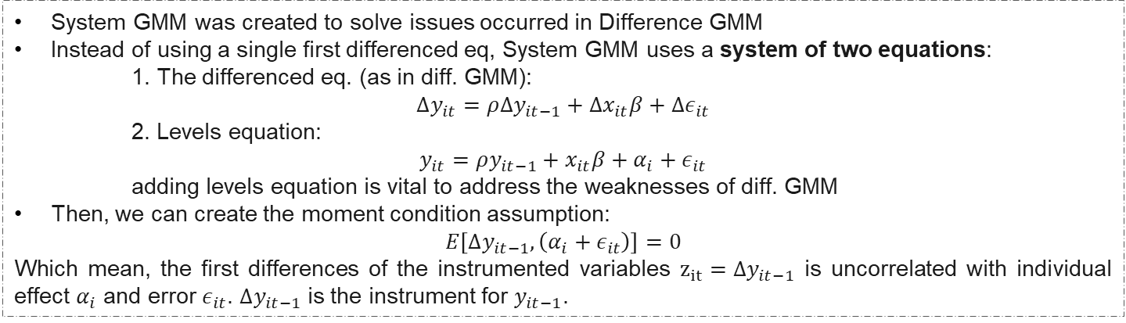
Difference GMM vs System GMM
System GMM (Arellano and Bover, 1995)
System GMM was created to solve issues occurred in Difference GMM
Instead of using a single first differenced eq, System GMM uses a system of two equations:
1. The differenced eq. (as in diff. GMM):
$$∆y_{it}=ρ∆y_{it−1}+∆x_{it}β+∆ε_{it}$$
2. Levels equation:
$$y_{it}=ρy_{it−1}+x_{it}β+α_{i}+ε_{it}$$
adding levels equation is vital to address the weaknesses of diff. GMM
Then, we can create the moment condition assumption:
$$E\left[∆y_{it−1},\left(α_{i}+ε_{it}\right)\right]=0$$
Which mean, the first differences of the instrumented variables $z_{it}=∆y_{it−1}$ is uncorrelated with individual effect $α_{i}$ and error $ε_{it}$. $∆y_{it−1}$ is the instrument for $y_{it−1}$.
Advantage
Challenges
Handles weak instruments
Uses both cross-sectional and time-series variation
Allows more valid moment conditions
Preserves level information
Too many instruments
Still biased if panel is very short
Relatively high computation. Works perfectly in a large data situation.

Slide 15
Difference GMM vs System GMM
Since system GMM acted as improvement of Difference GMM, this approach acknowledge the biggest weakness of Difference GMM which is weak instrument. This approach is solved by including both levels and first difference transformation on the instruments.
However, System GMM estimation believe to has more complex calculation and need adequate data in order to gain best result. Hence, as long as we have enough data, System GMM is preferred.
Furthermore, since both approaches use to obtain more efficient result, the estimation should be somewhere between OLS (upper-bound) and FE/RE (lower-bound)! So, if Diff-GMM estimated values is over the OLS, use system GMM instead.

Slide 16
Thank You

